Slide 1
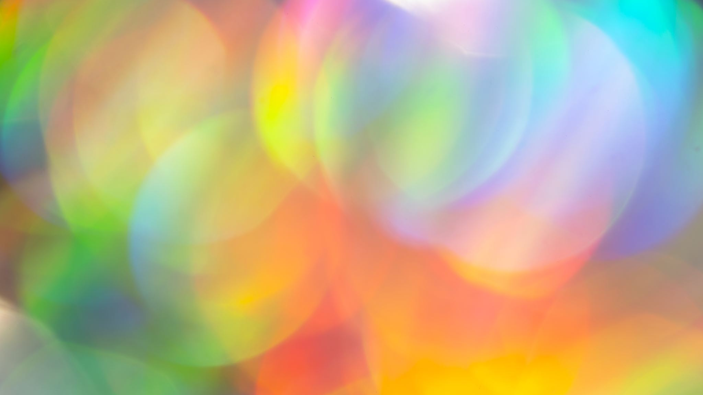
Art process portfolio
By：Silvia Cai

Slide 2
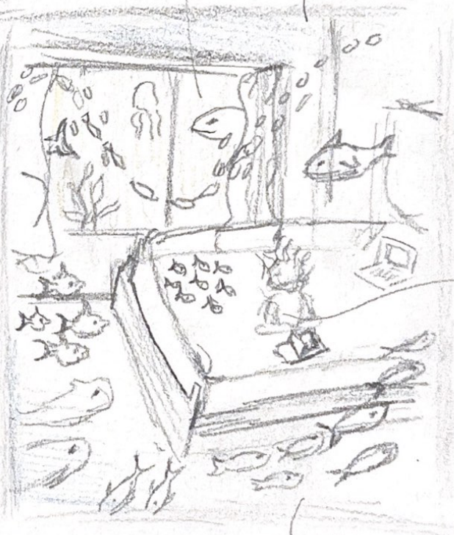
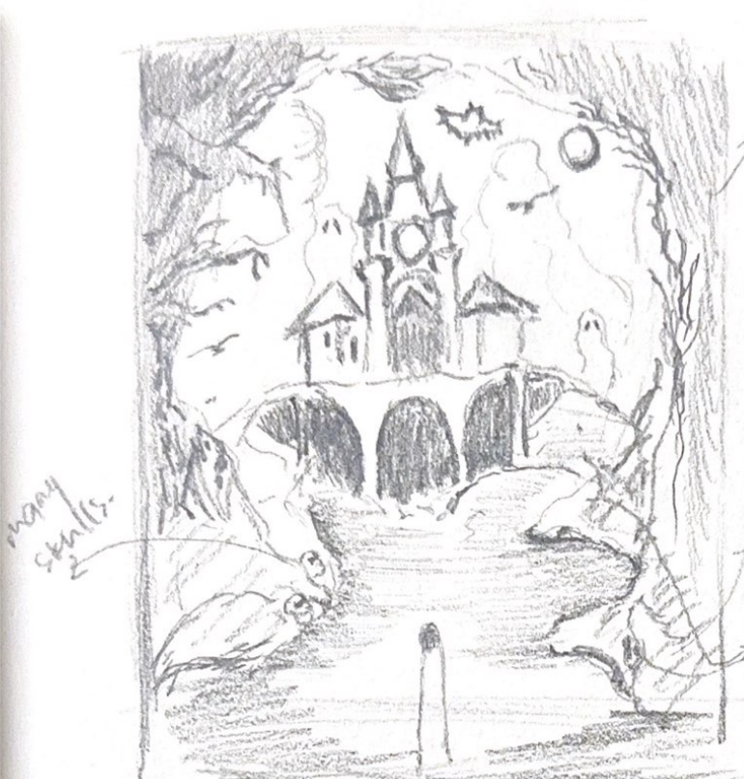
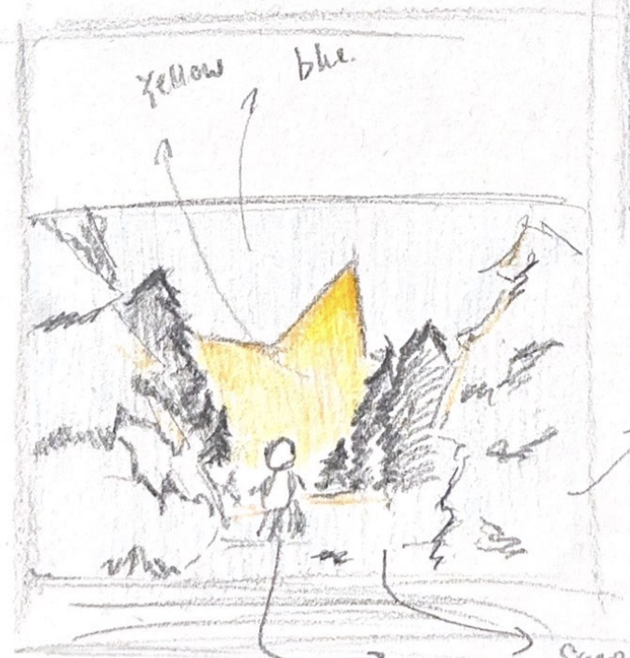
Idea exploration
Idea 3: the third idea is a dream that I had for 1 entire year. When I was around 5 years old I went to a haunted house in a zoom with my brother and my cousins. Before entering the haunted house, I didn’t know that there are things scary. After coming out from the house my mom said that my face and lips are all white. This was a nightmare for my childhood.
Idea 1 : For the first idea I took inspiration from my bed room and ocean. When I was little I had a dream about the whole world is under the ocean and we are living normally under ocean. In the sketching there are many fishes, corals and algae. There are also thing that present in my bad room for exapmle my bad and window.
Idea 2: For the second idea I dreamed about the a meteoroids falls near our house, and we are living somewhere cold in the forest. In the sketch shows different layers of pine trees that create a foreground and a background.

Slide 3
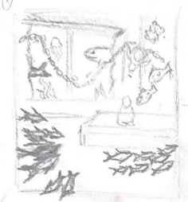
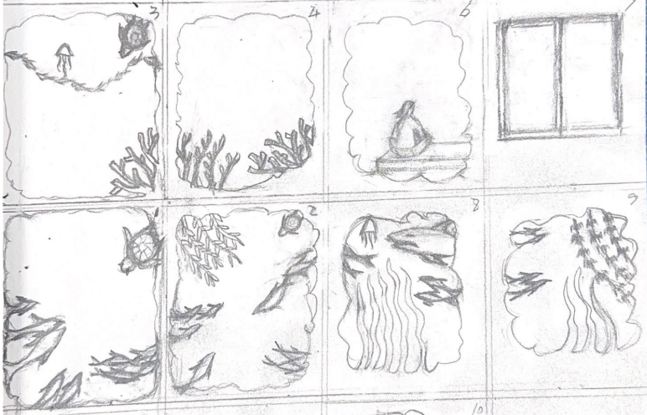
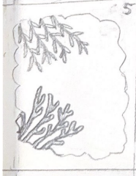
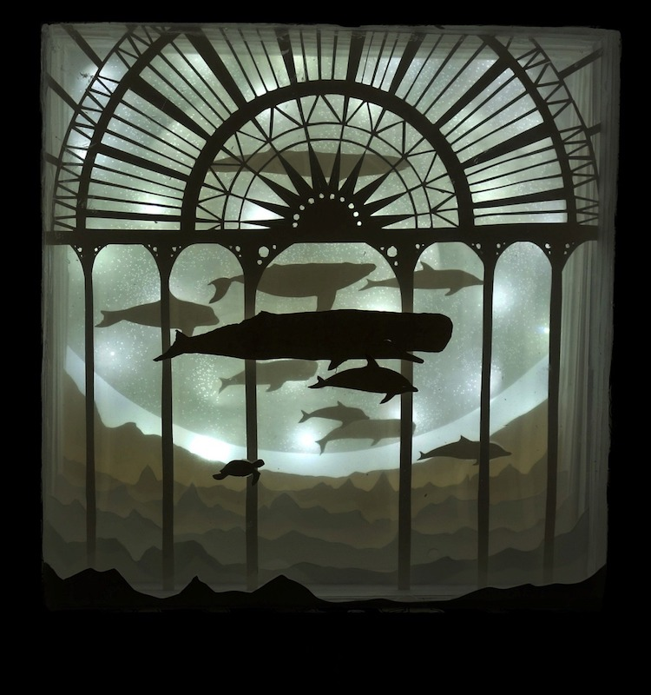
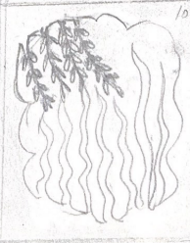
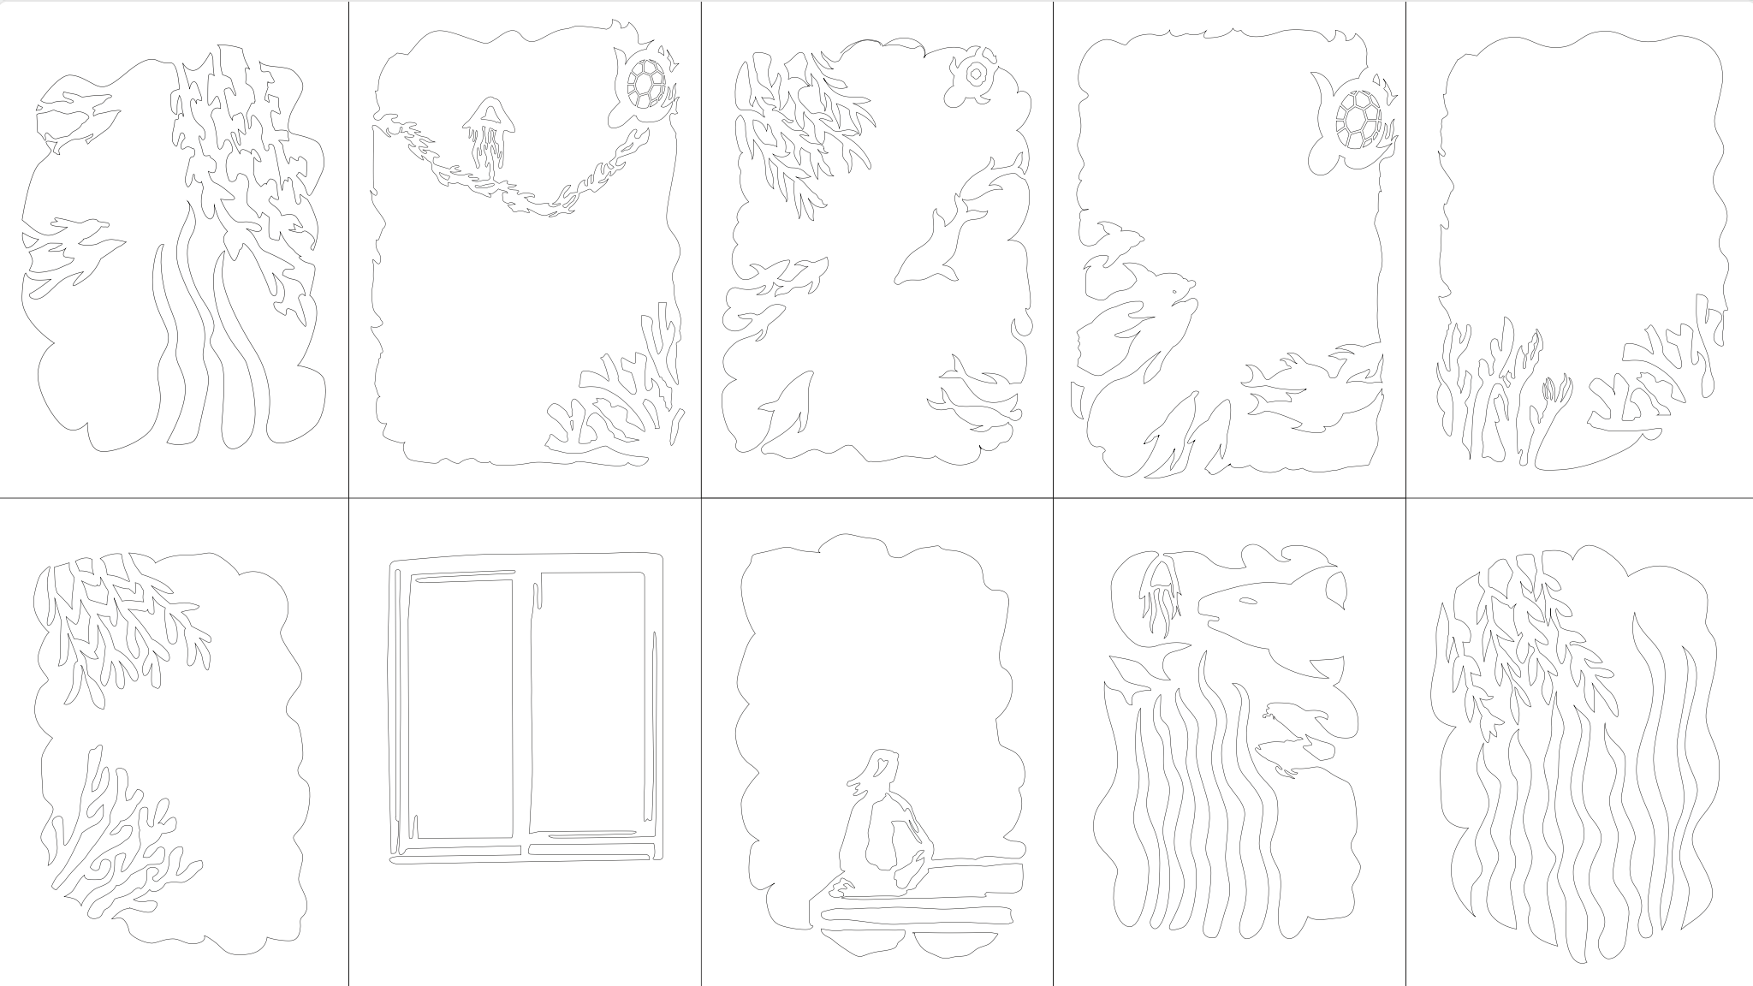
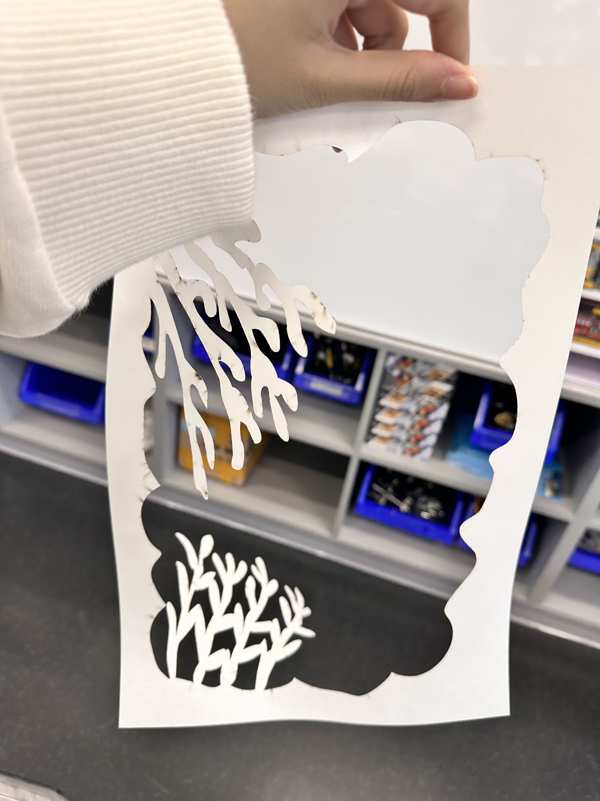
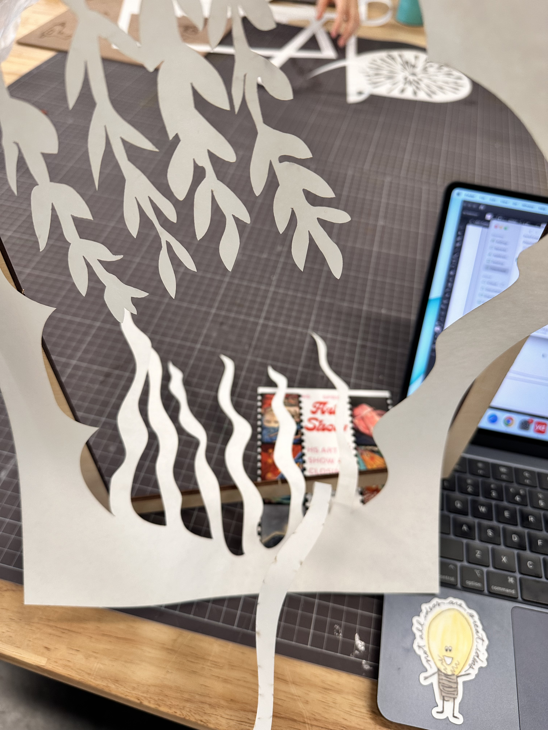
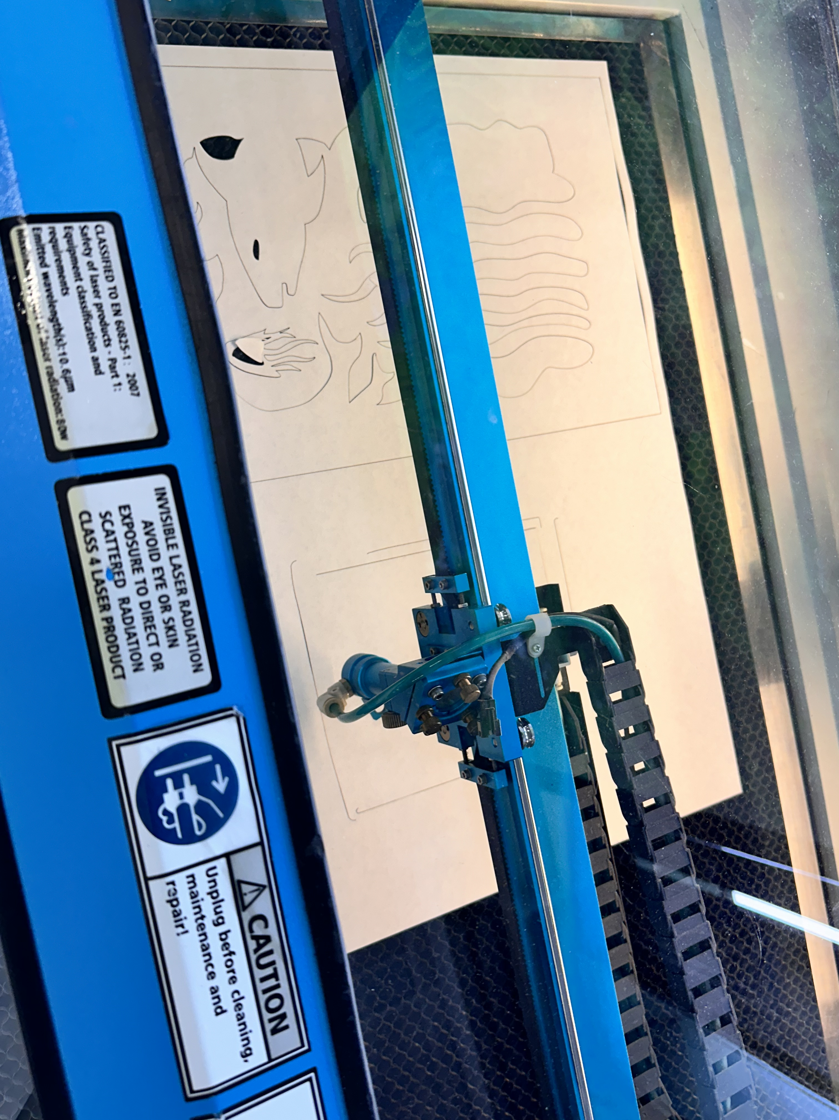
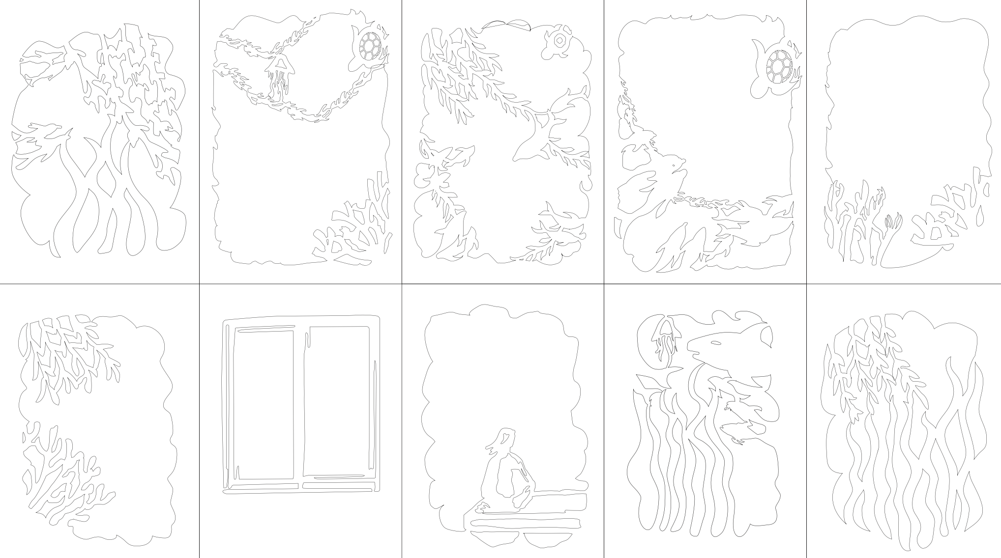
Artist research + Project development
The artist that I researched about is Aline Mare.
Aline Mare gets her ideas from nature, movies, and her own feelings. She begins with a main idea but doesn’t plan everything out. Instead, she uses her creativity and imagination to guide her as she creates each light box.
I first drew all the 10 pannels in my sketchbook with pencil, then I scanned it with my phone and sended it to the illustrater file.
These are the first 10 panels that I traced. After I cut all the 10 panels I realize that a lot of the panels are not working for the light box because the paper it to thin the algae cannot be hold straight up as the panels.
Aline Mare's paper creations, featuring mythical dragons and forest creatures, look like they come from a fairytale. In one piece, whales swim through stormy seas, and in another, turtles and seahorses explore a sunken ancient city.
I was inspired by Aline Mare's work because it shows a link between our world and life under the sea. Her detailed designs of sea creatures and underwater scenes remind me of my dreams. Her art makes me appreciate the natural world and its mysteries.
I adjusted and redesigned 8 of the panels. I made more connection between each fish and algae, then I recut all the 8 panels and this time the panels worked well.

Slide 4
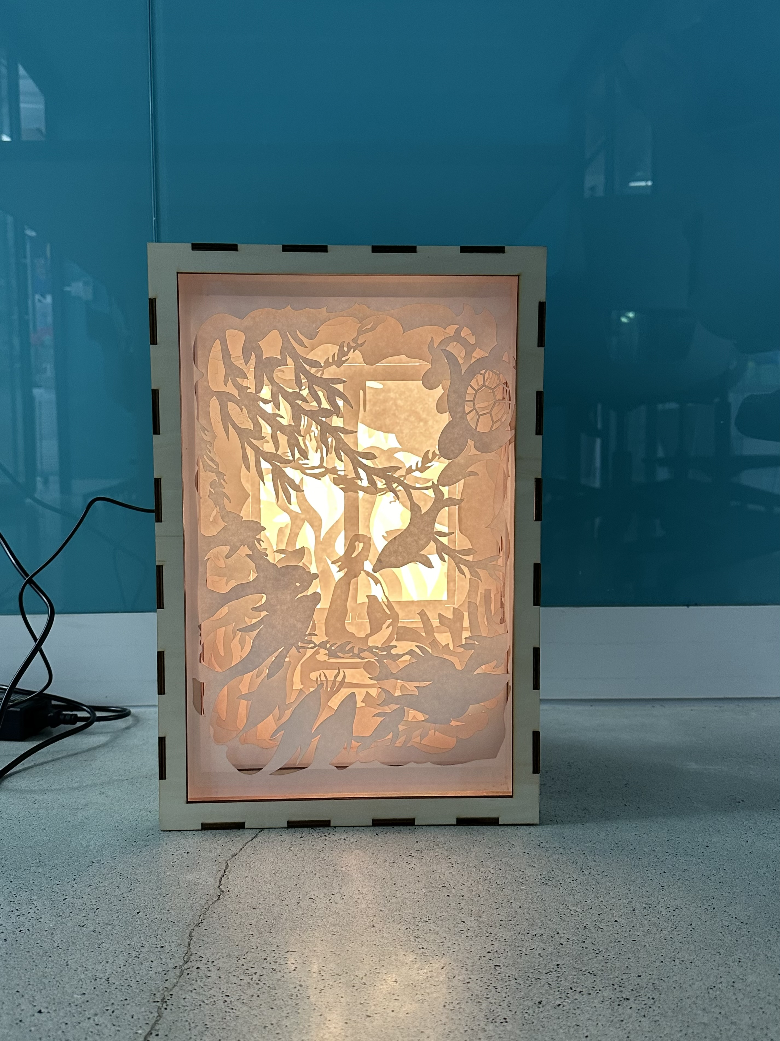
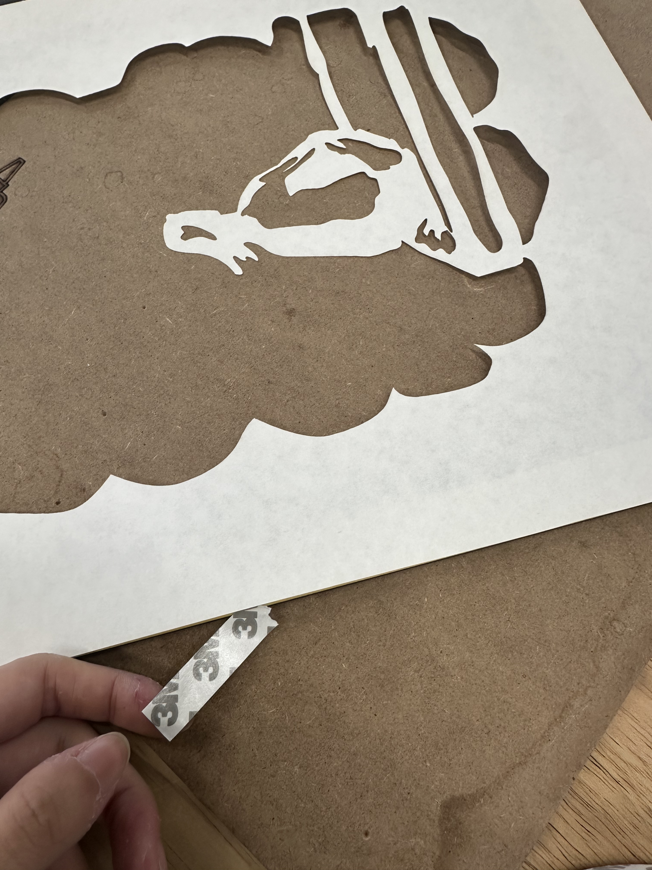
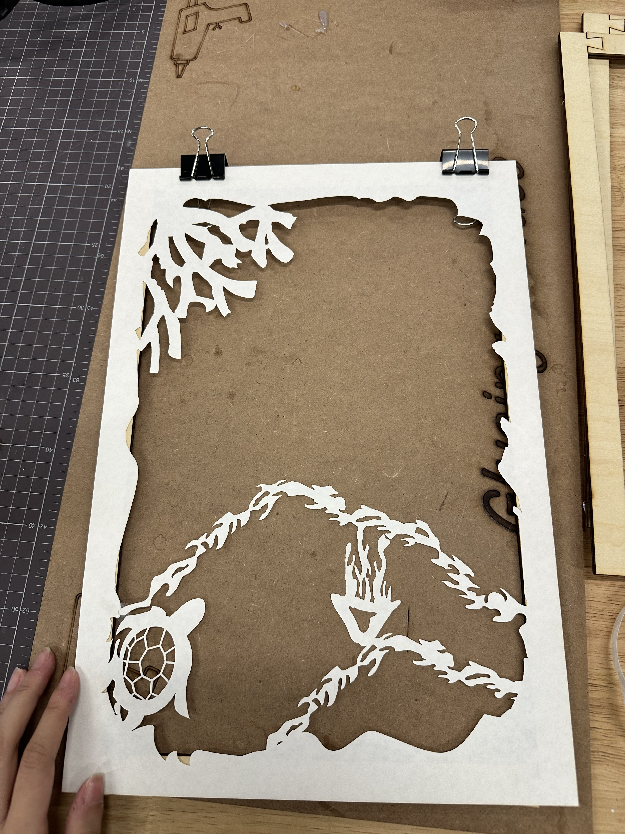
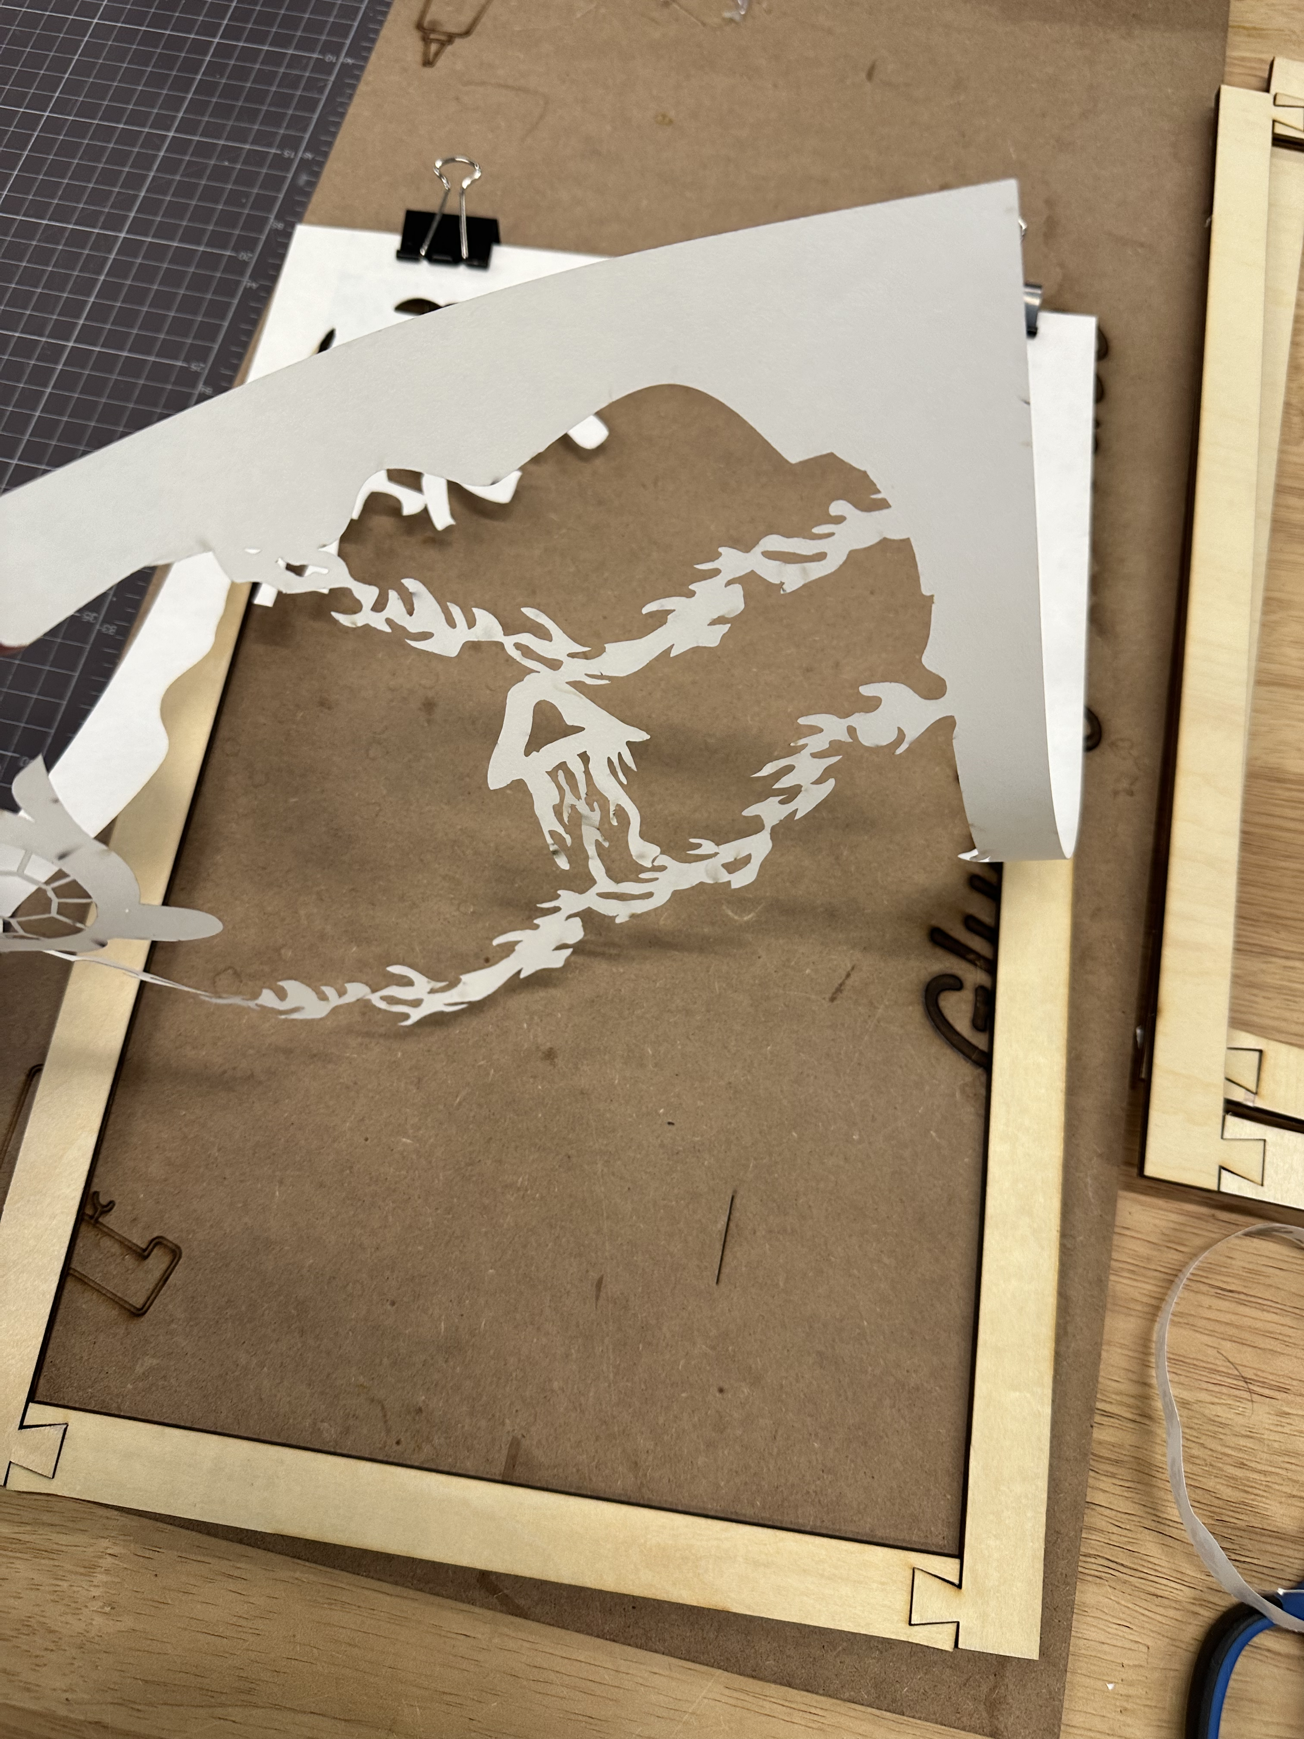
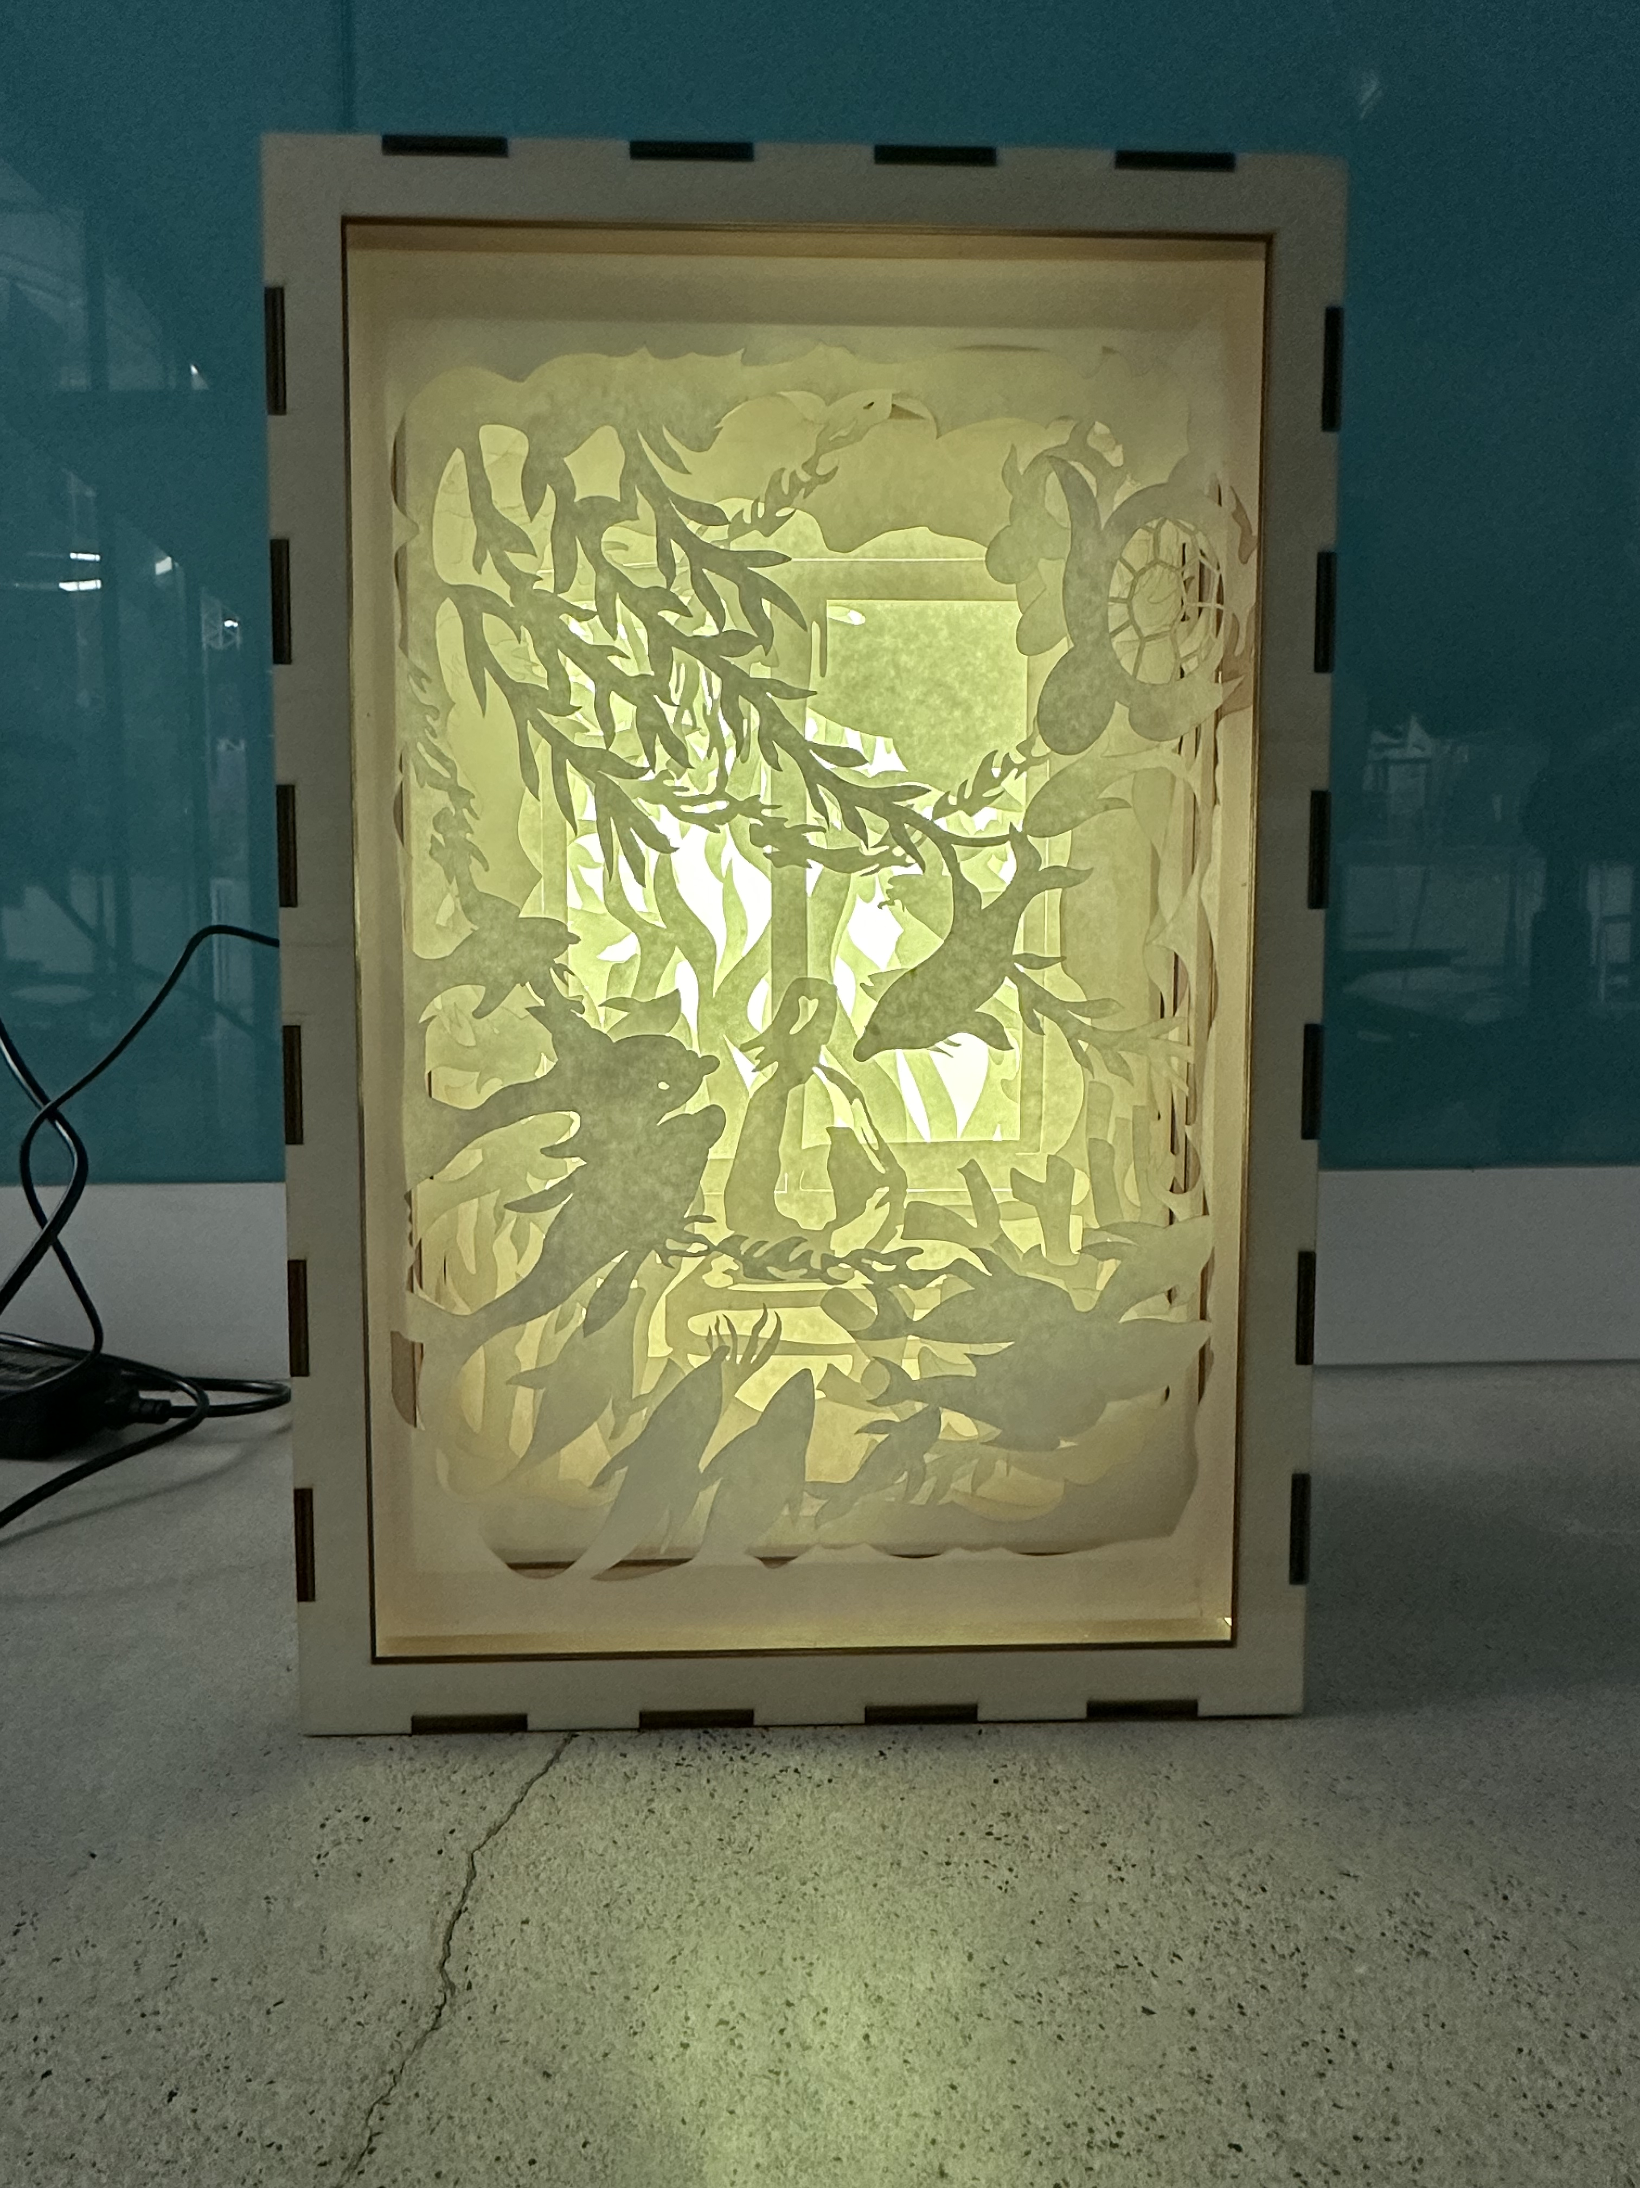
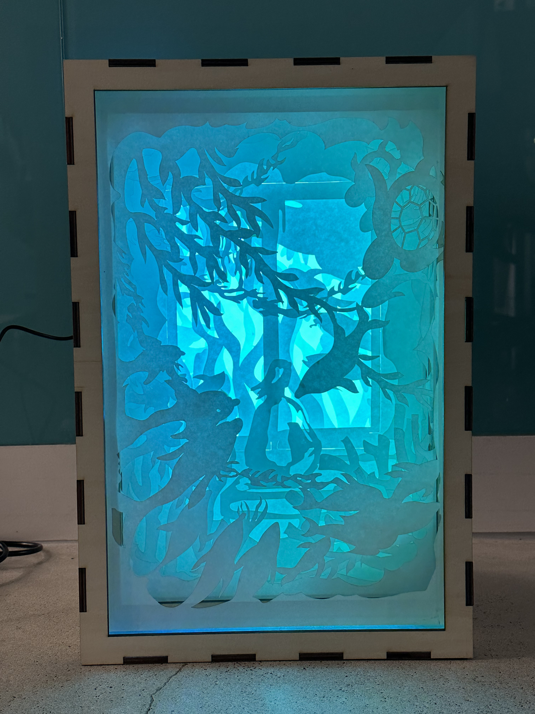
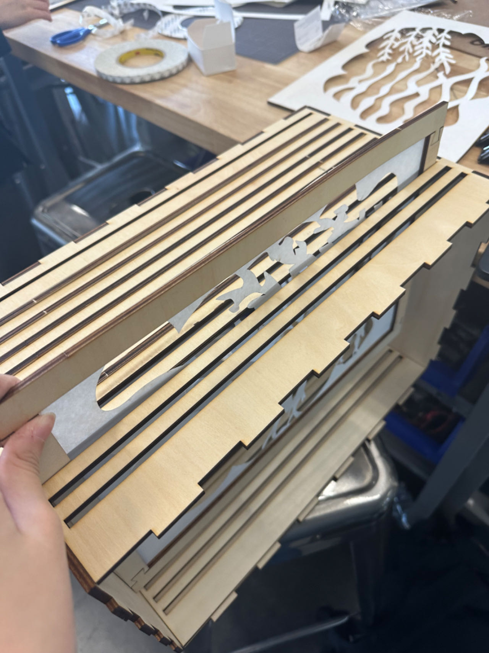
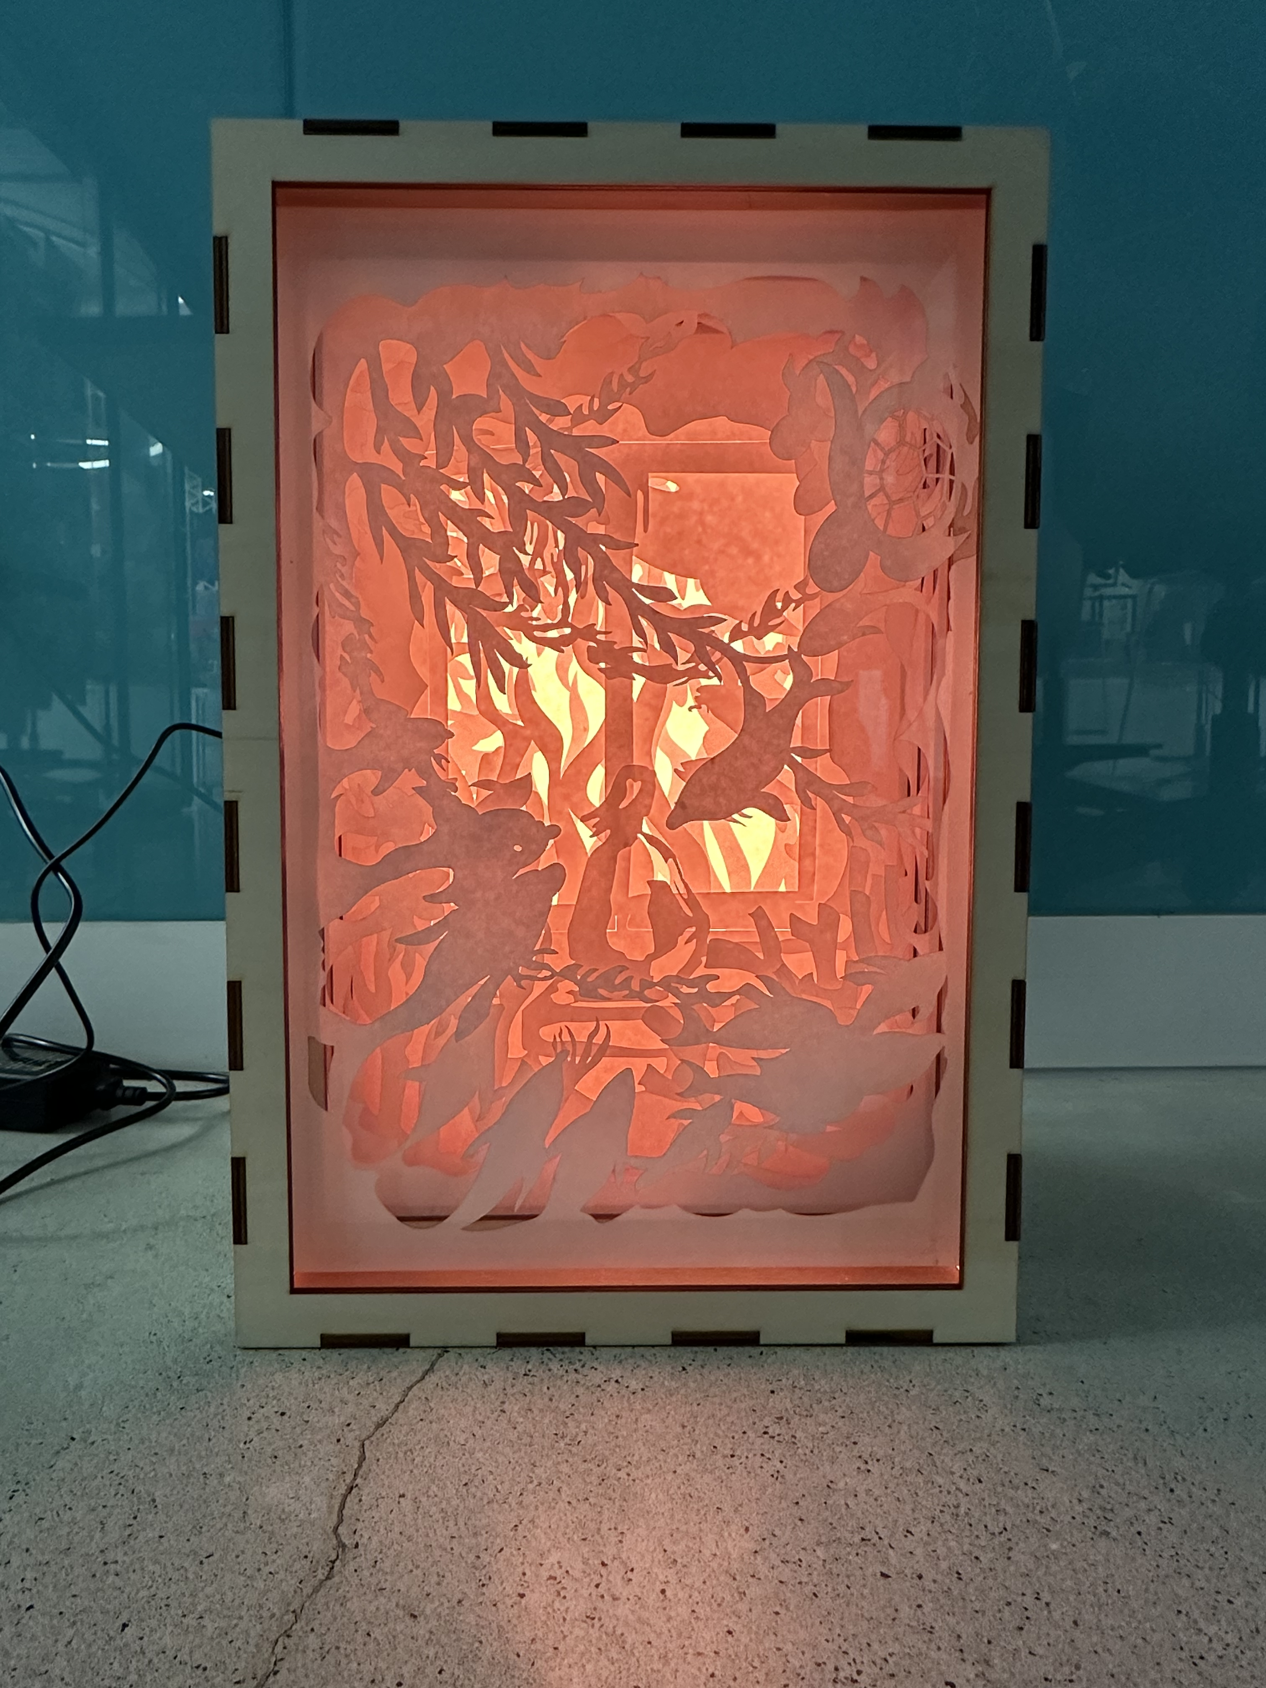
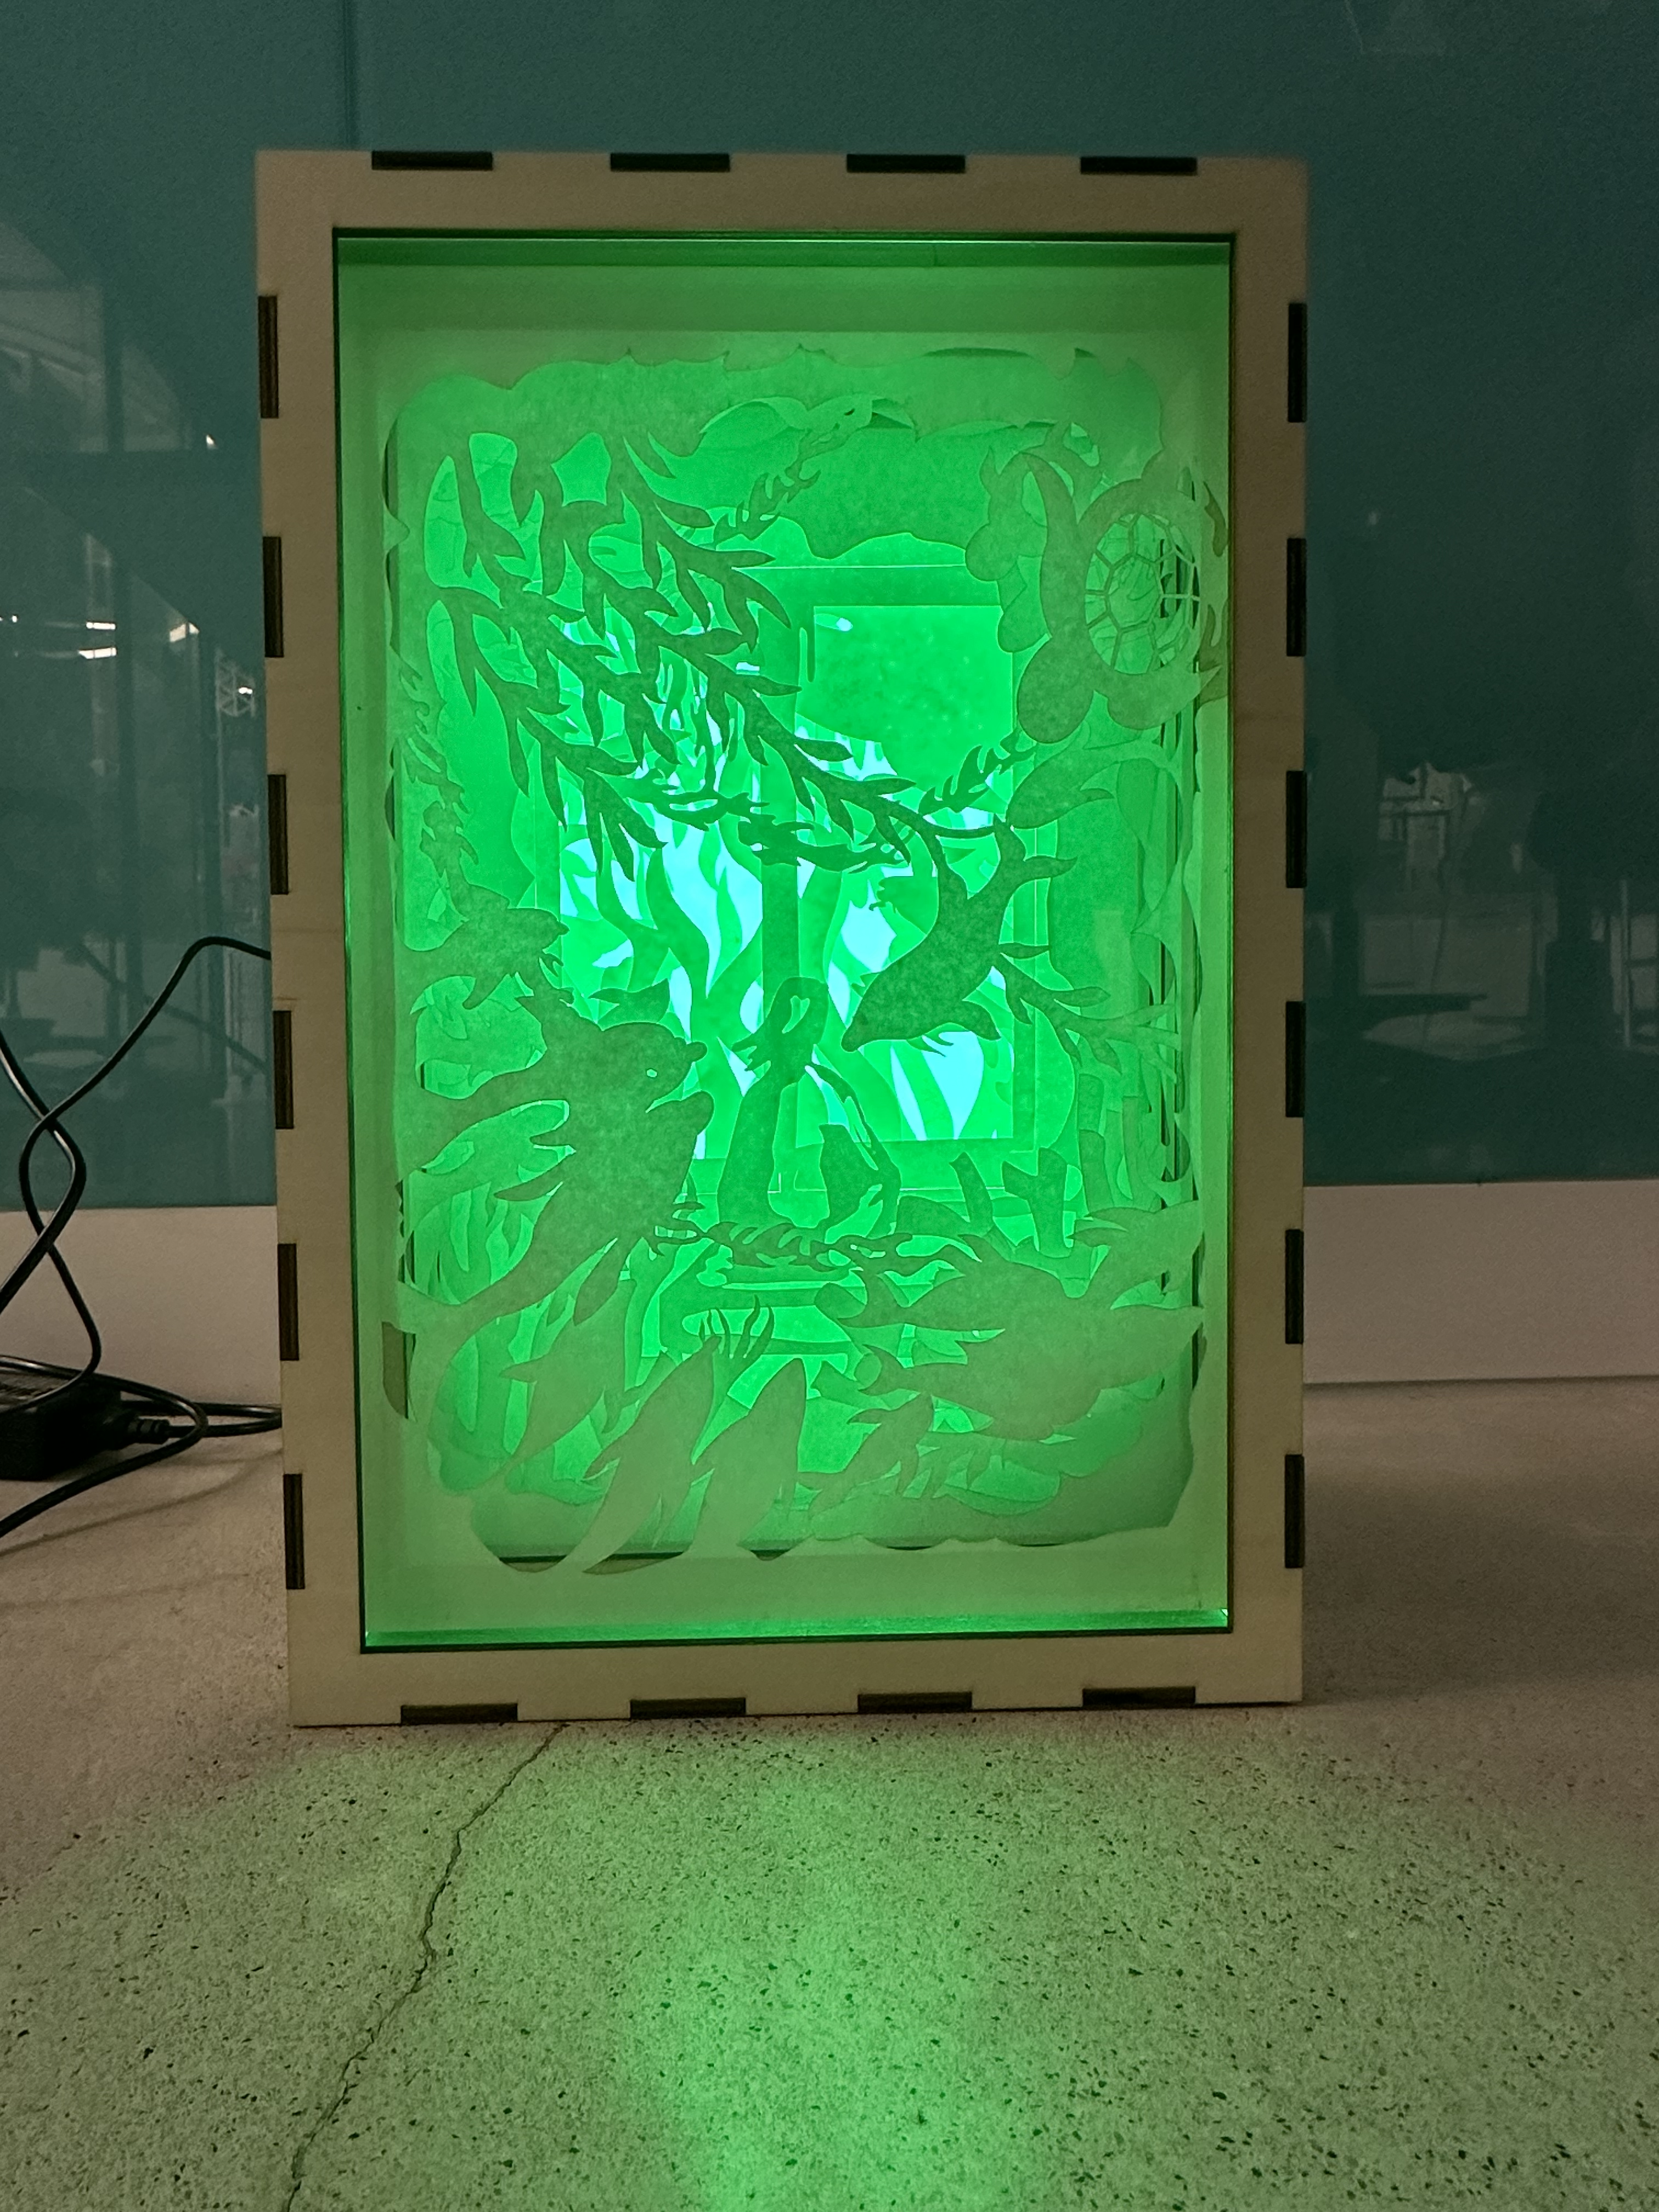
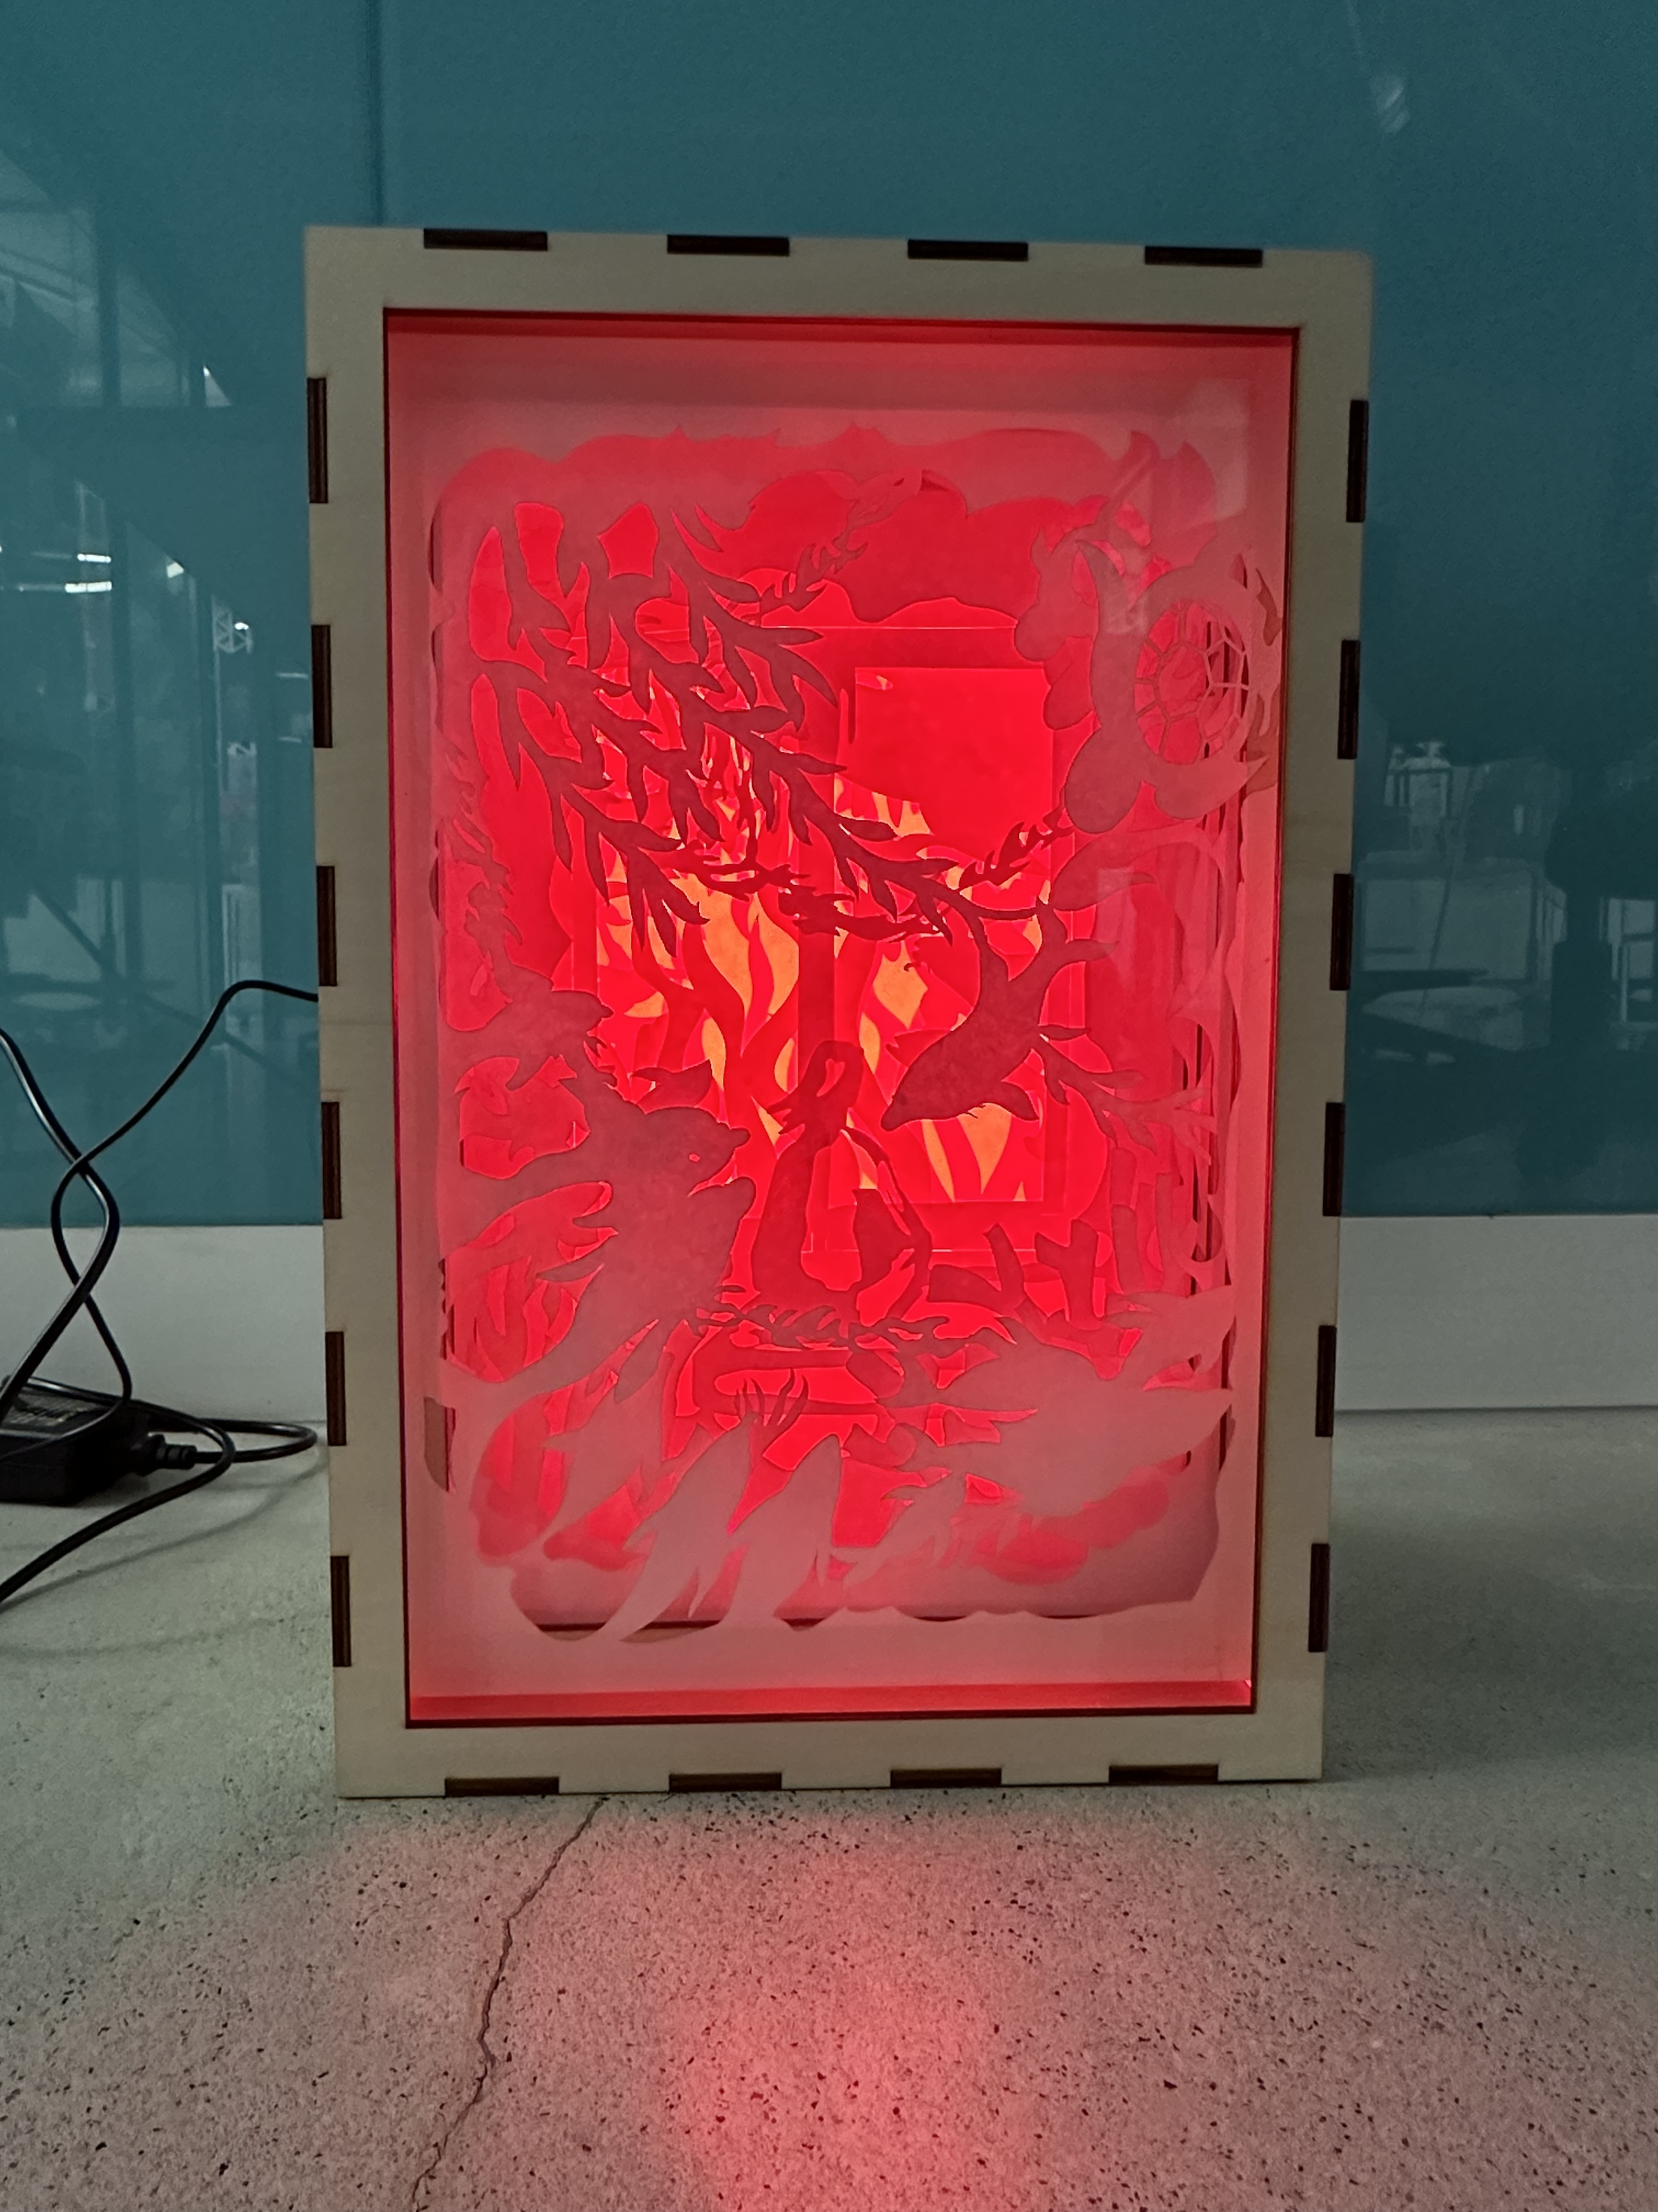
Project development + Final project
These are the photos of my final product. I choose to put different color photo to present different emotions. The color of the room varies based on my emotion. So for example the yellow and orange color represent a me in comfort, green and blue color represent when I am feeling happy and color red is when I am mad and angry.
After having all ten panels cut. I made the wood frames and the light box to make the panels stand up. We use the double sided tape and some paper clip to stick paper panels on the wood frame. I sticked only the top and the bottom of the frame. I also used two little piece of tape to stick the side. After that I slide all the panels into the box that we had made.

